Slide 1

INFO 5550 Data Mining Project
Submitted By:
Shubham Gandam

Slide 2
INTRODUCTION
Welcome, everyone, to our Data Mining Project presentation. Today, we invite you on a journey through insights and analysis as we navigate a rich dataset. This project, constituting 15% of our course grade, has empowered us to apply our newfound skills in both Excel and Power BI.
As a team, we've embraced the opportunity to structure our analysis independently, focusing on two states for comparison against the backdrop of Alabama's data. This exploration encompasses the key components of Excel, from functioning models to pivot tables, charts, and slicers. In tandem, we've harnessed the capabilities of Power BI, incorporating map visuals and additional insights.

Slide 3
Our commitment to professionalism and equal contribution is reflected in the seamless collaboration of our team members. Beyond the technical aspects, we've distilled actionable business findings and recommendations from our analysis.
In the next 8-10 minutes, we aim to provide a concise yet comprehensive overview of our data-driven journey. So, without further ado, let's dive into the heart of our exploration and uncover the stories hidden within the numbers.

Slide 4
Excel Work

Slide 5
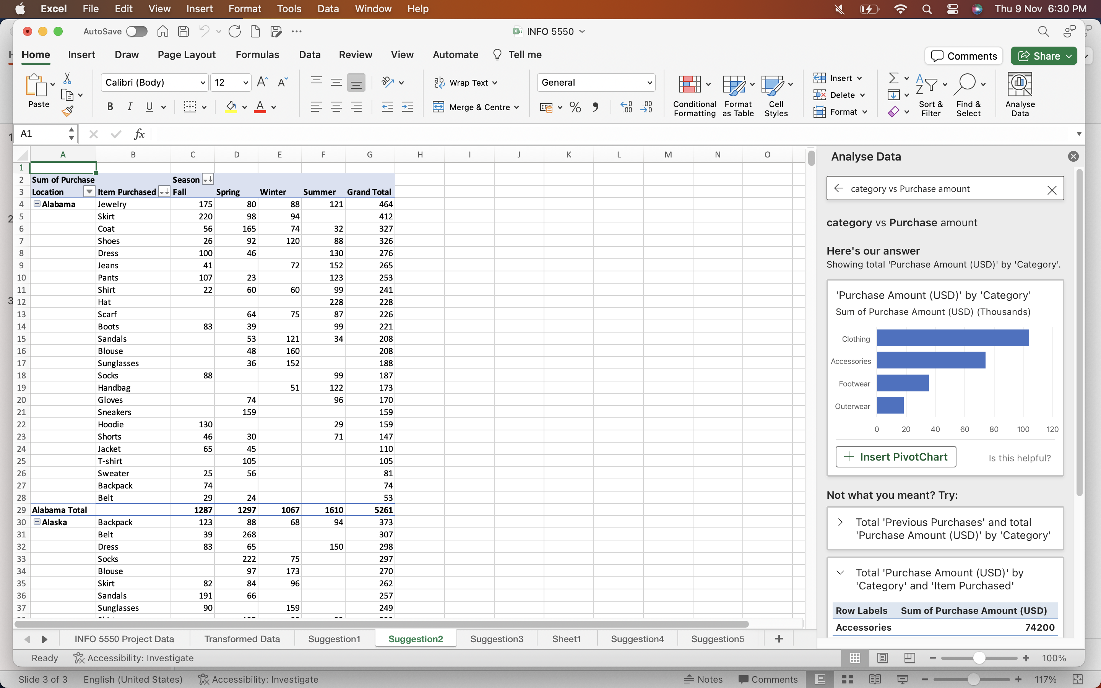
State wise Distribution

Slide 6
By category and Gender

Slide 7
Previous purchases

Slide 8
Purchase amount by gender

Slide 9
Previous purchase by gender

Slide 10
POWER BI WORK

Slide 11
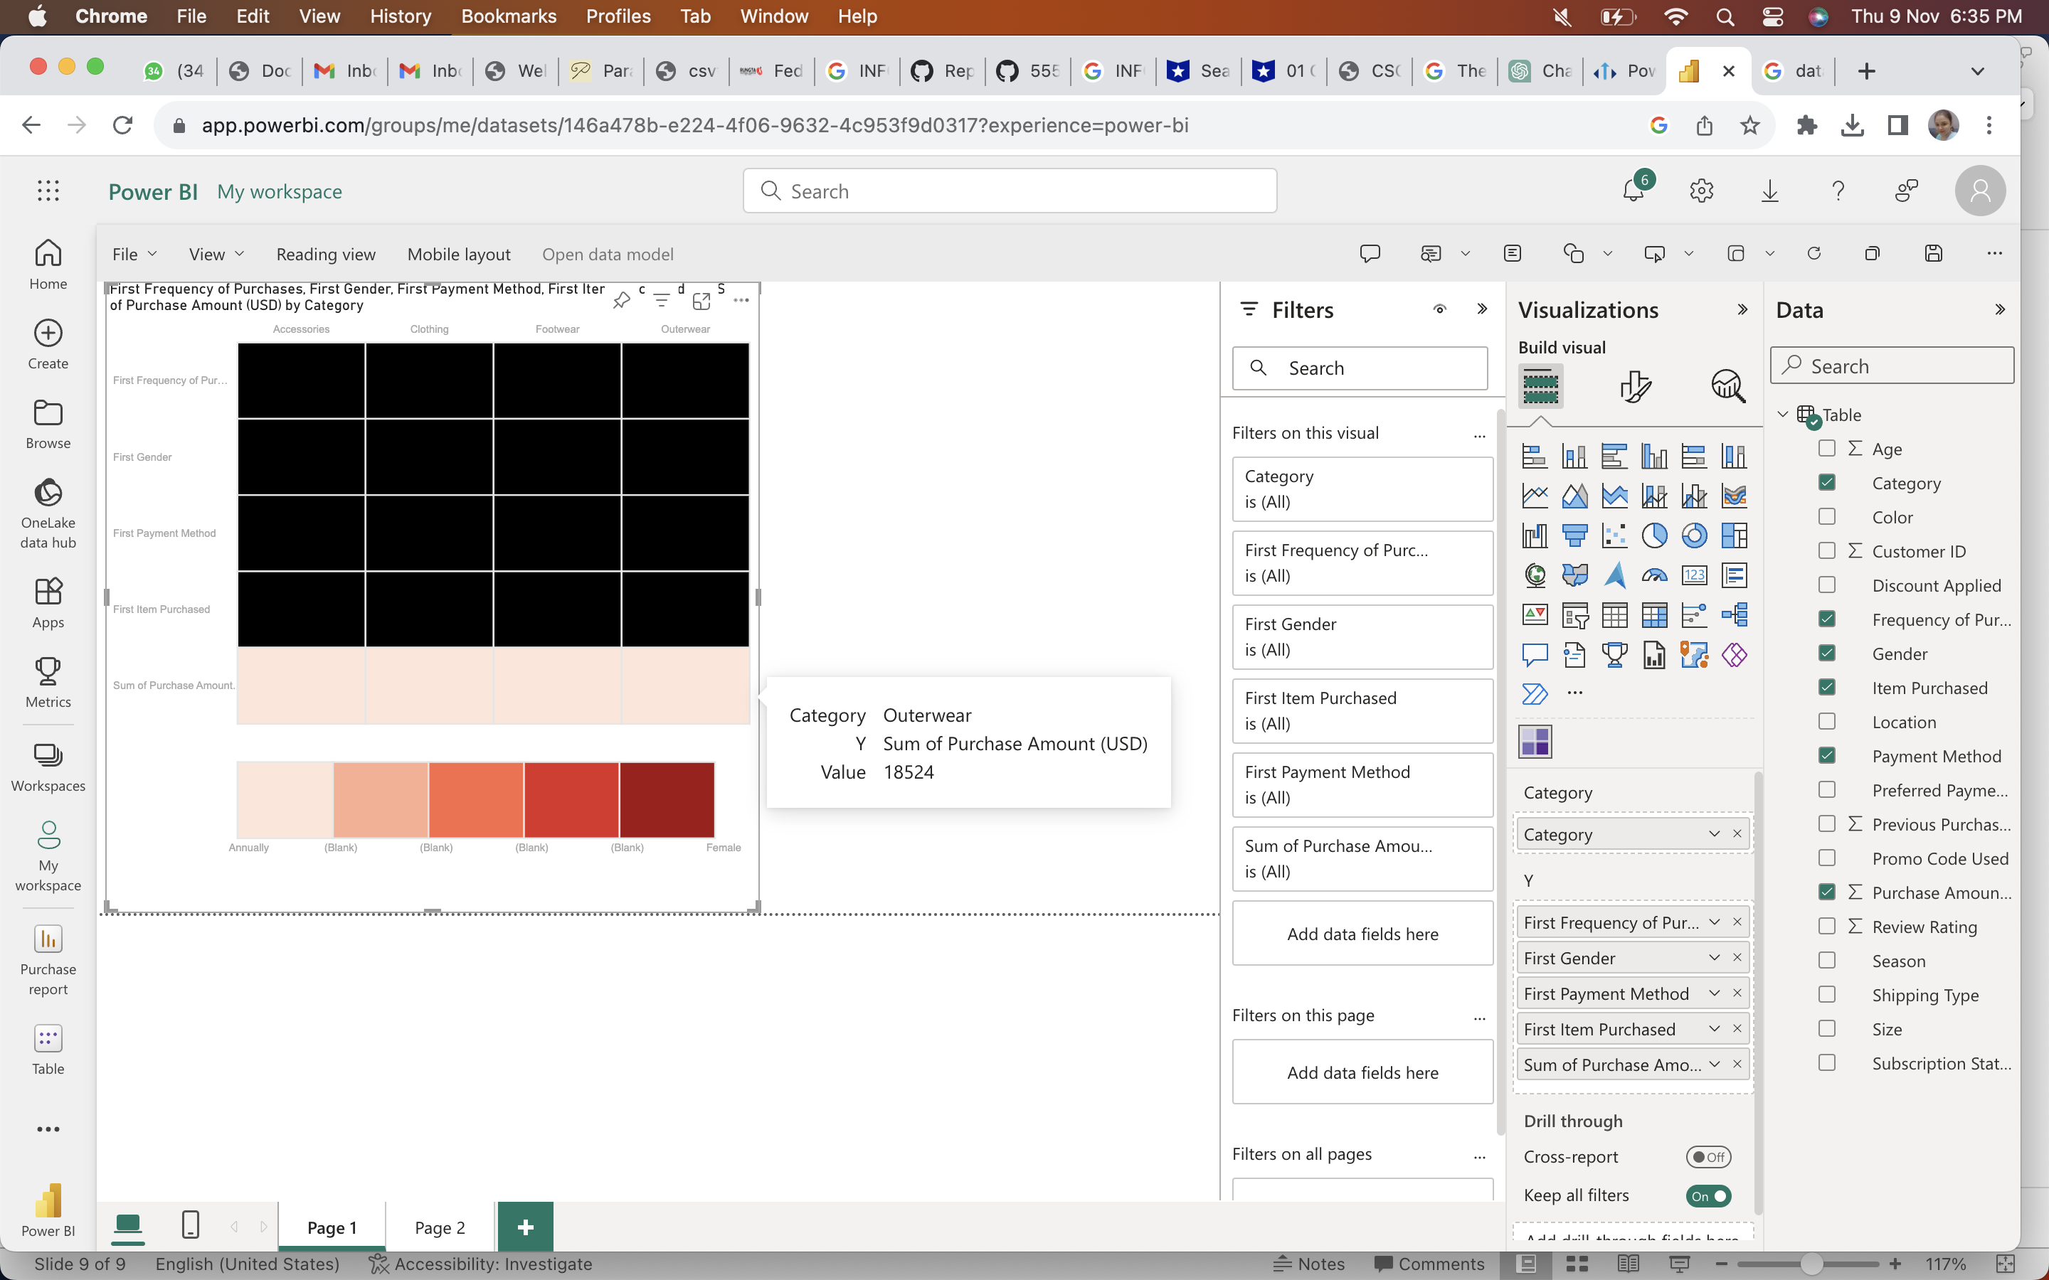
Heat Map

Slide 12
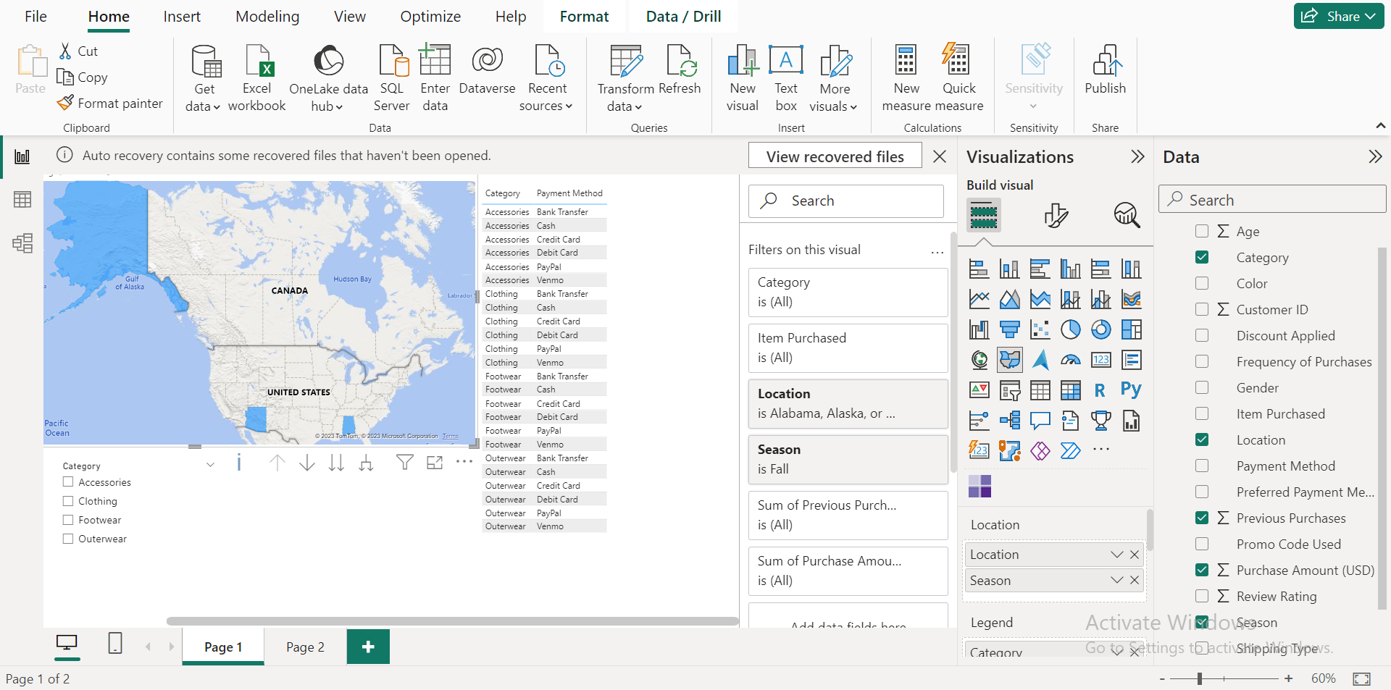
Map Visual

Slide 13
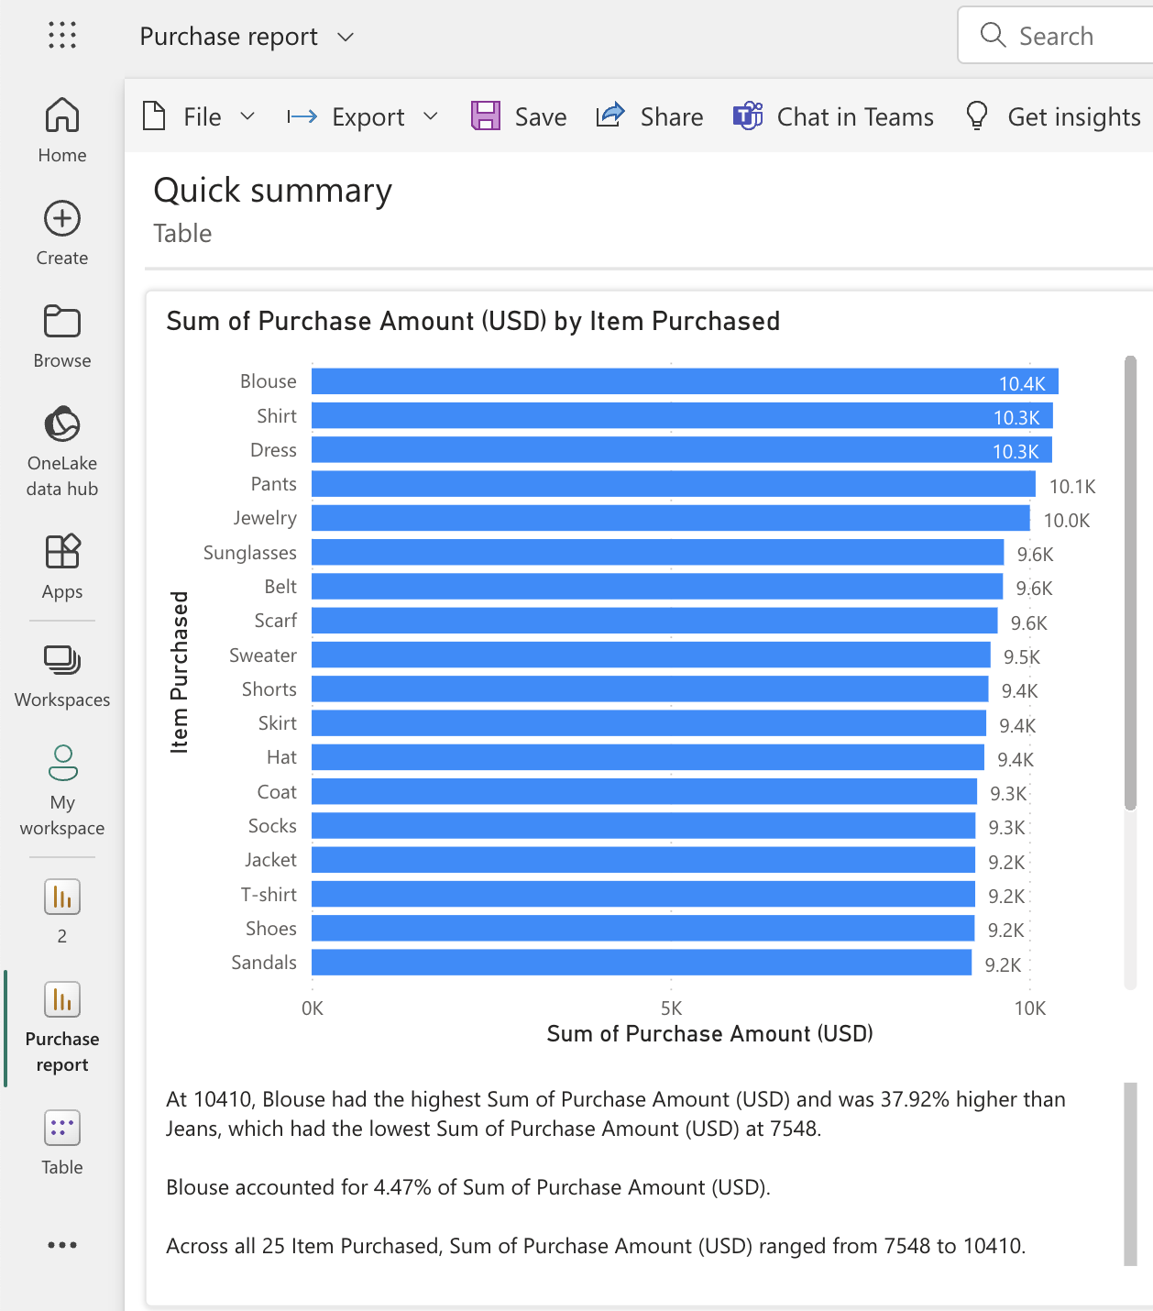

Slide 14
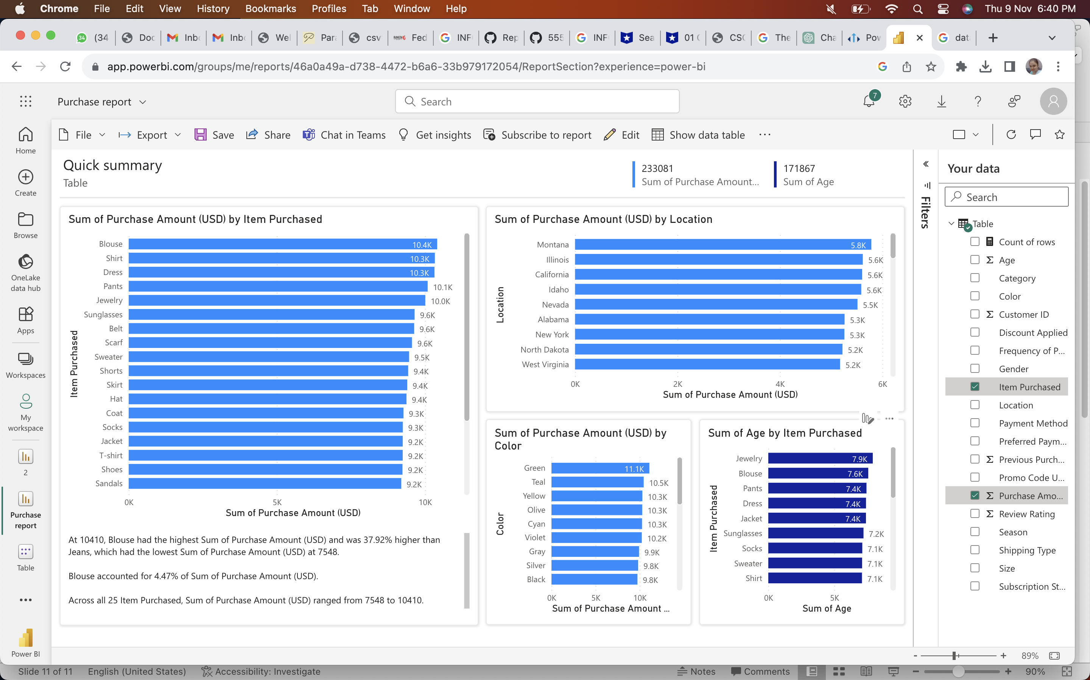

Slide 15
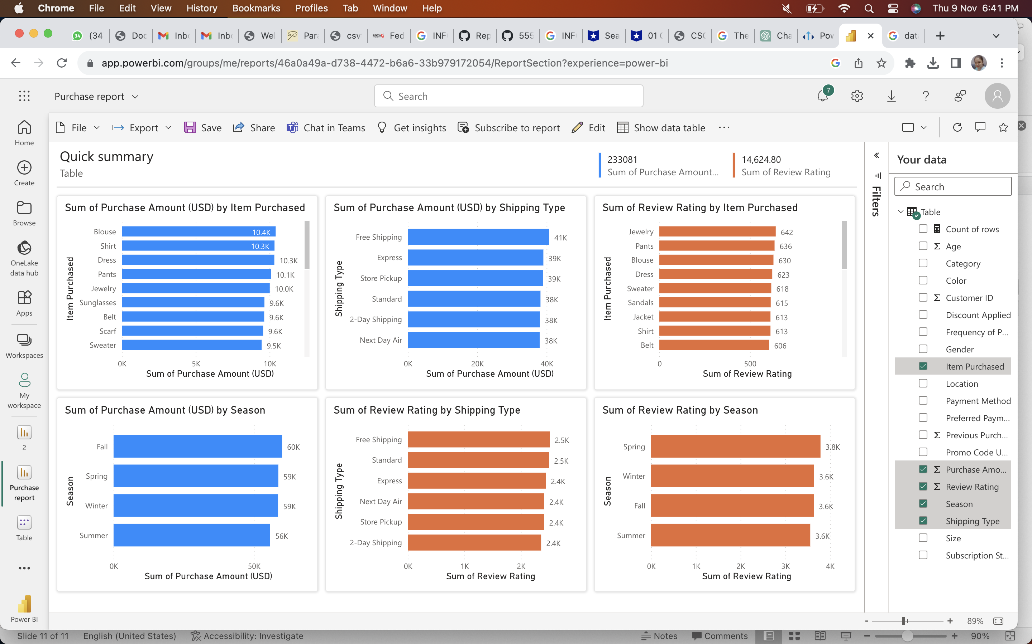
SHIPING PURCHASE

Slide 16
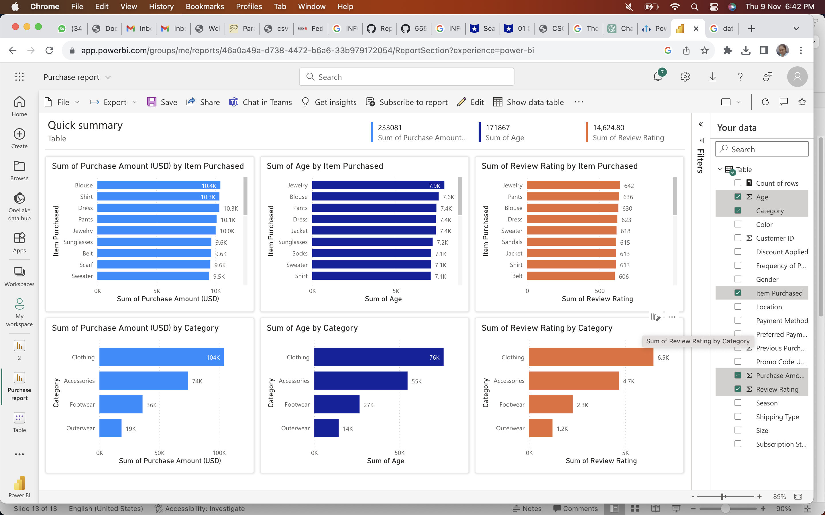
RATING

Slide 17
CONCLUSION
In conclusion, our data mining odyssey has not only been a journey through numbers but a revelation of insights and possibilities. We started by navigating the landscape of our dataset, wielding the analytical tools of Excel and Power BI.
From the functioning models and pivot tables in Excel to the dynamic visuals and powerful functions in Power BI, each facet of our analysis has contributed to a richer understanding of our data.
As we compared and contrasted two states with Alabama, patterns emerged, and anomalies were unearthed. The meticulous application of techniques discussed in class ensured depth and precision in our findings.

Slide 18
Our business insights, distilled from the data, have led us to not just observations but actionable recommendations. Whether it's predicting a business outcome or highlighting a key finding, our analysis is a compass pointing towards informed decision-making.
We, as a team, have not only met but exceeded the requirements, with each member contributing equally to the success of this project. The professionalism exhibited in our presentation reflects our commitment to delivering a polished and insightful analysis.
In the end, data isn't just numbers; it's a narrative waiting to be told. Today, we've shared a chapter of that narrative, and as we conclude, we invite you to explore further, question deeply, and embrace the transformative power of data. Thank you for joining us on this exploration, and we're open to any questions or discussions you may have.

Slide 19
THANK YOU!!!!!!

